Slide 1
Ansible role
ow

Slide 2
Defination
An Ansible role is a collection of tasks used to configure a host for a specific purpose, such as configuring a service.
YAML files with a predefined directory structure are used to define roles.
The following directories are found in a role directory structure: defaults, vars, tasks, files, templates, meta, and handlers.
A role is a set of tasks and additional files that are used to configure a host to serve a specific role. A playbook is a mapping of hosts and roles.

Slide 3
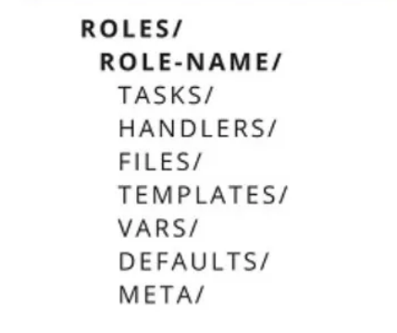
..
To create an Ansible role, use the ansible-galaxy command, which includes templates.
This will create it in the default directory /etc/ansible/roles and make the necessary changes
we must manually create each directory and file. where ansible-galaxy is the command used to create roles from templates.

Slide 4
..
tasks — contains the main list of tasks that the role must complete. handlers — a collection of handlers that can be used by this role or anywhere else. defaults — the role’s default variables. vars — additional variables for the role. Vars takes precedence over defaults. files — files that must be transferred or deployed to the target machines via this role.
templates — a collection of templates that can be deployed using this role. meta — specifies some data / information about this role (author, dependency, versions, examples, and so on).

Slide 5
Lab 21

Slide 6
Create a project
The include_tasks directive in Ansible is used to dynamically include a list of task files during playbook or role execution. In the context of roles, include_tasks can be utilized to split and organize tasks into smaller, more manageable files, and dynamically include them based on conditions or logic.
We will use multiple tasks file
Handler
Var

Slide 7
Check full lab
Pdf will be shared and explained

